Slide 1
Junior
Grades 4-6

Slide 2
Allergen Options
Egg
Milk
Mustard
Tree Nut
Soy
Peanut
Seafood
(fish, shellfish, crustaceans)
Sesame
Wheat
Sulphites

Slide 3
Note
Ingredients can vary from food to food
Goal of the game:
Determine what allergens are most likely within each food
Learn how allergens can be unexpected ingredients in foods

Slide 4
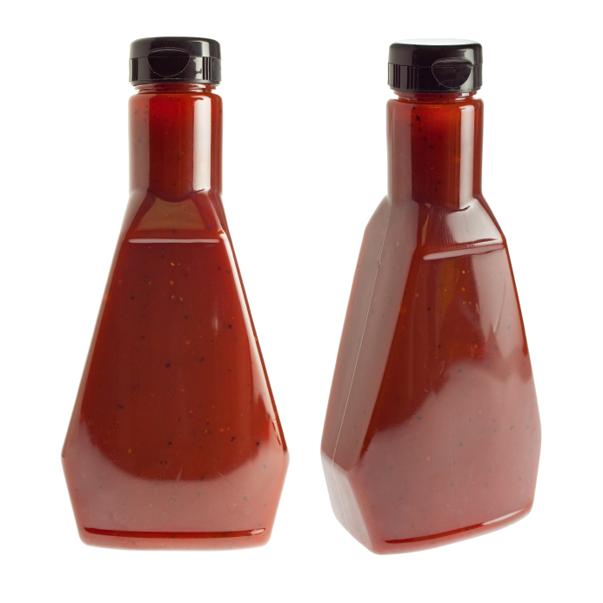
BBQ Sauce

Slide 5
BBQ Sauce

Slide 6
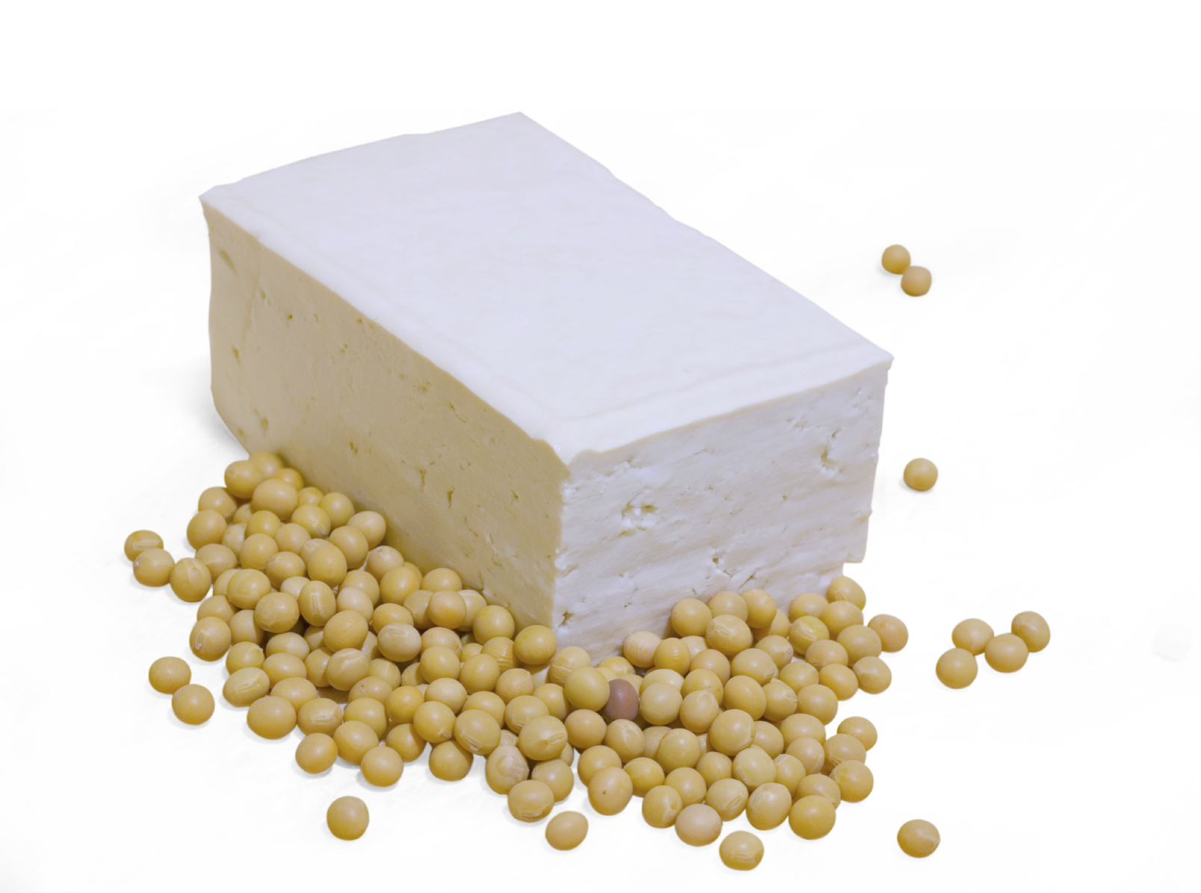
Tofu

Slide 7
Tofu

Slide 8
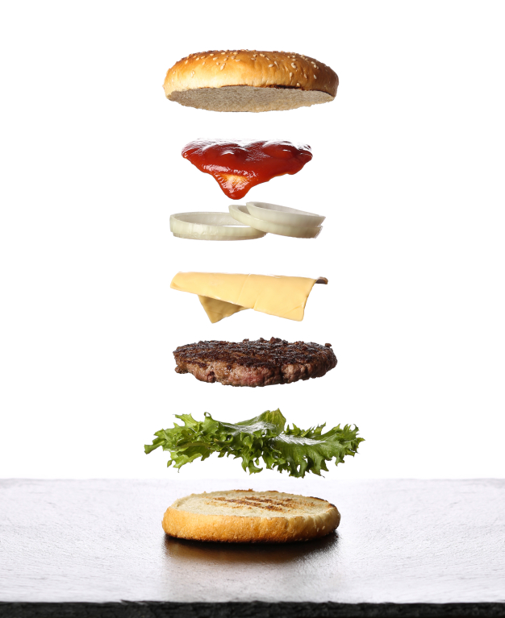
Hamburger

Slide 9
Hamburger

Slide 10
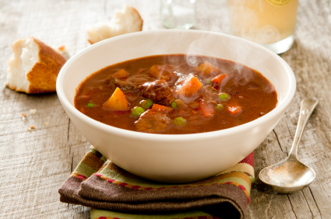
Stew

Slide 11
Stew

Slide 12
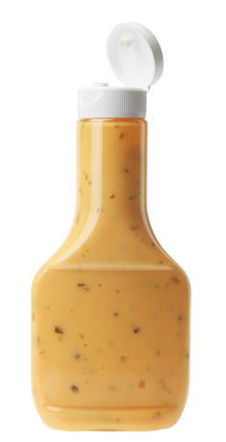
Salad Dressing

Slide 13
Salad Dressing

