Slide 1
Sabrina’s Story
Lessons Learned from Anaphylaxis

Slide 2
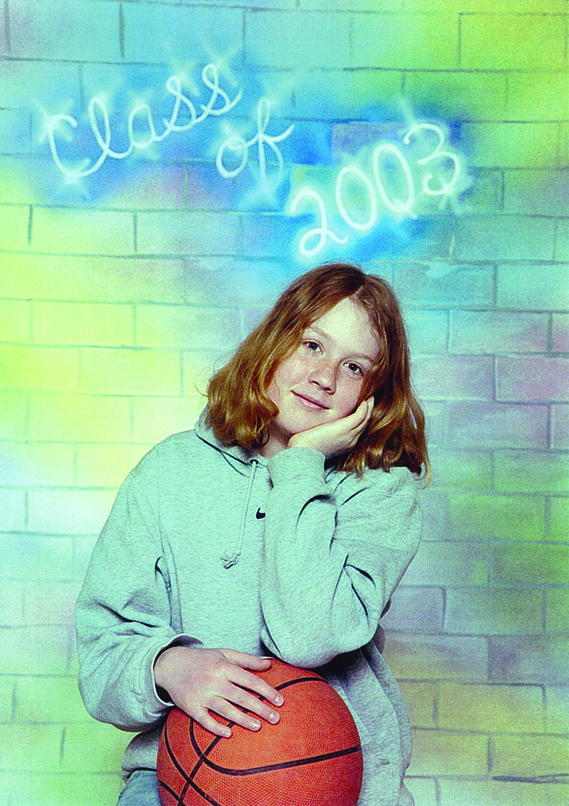
Sabrina Shannon
13 years old
First year in high school
From Pembroke, ON
Allergic to peanuts, dairy and soy

Slide 3
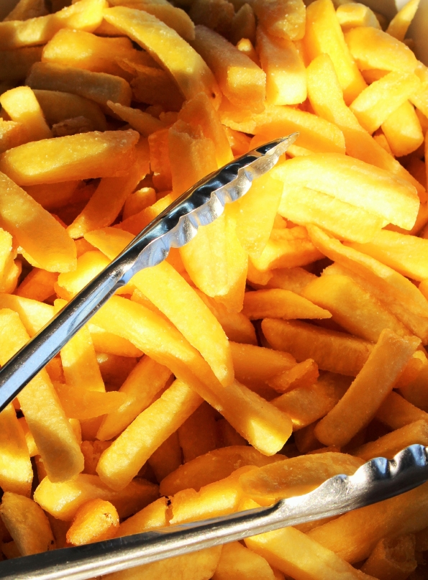
The Slip-Up
She ordered french fries at the school cafeteria
Fries were served using same tongs as those used for poutine
Why would this be an issue?
What allergen cross-contaminated the french fries?
How could cross-contamination, in this situation, been prevented?

Slide 4
The Reaction
Symptoms came on quickly
Within minutes she was having trouble breathing
Others thought she was having an asthma attack
Went to look for her asthma puffer

Slide 5
Anaphylaxis
It was an anaphylactic reaction
Not an asthma attack
Too much time passed before anyone knew it was a serious allergic reaction
By the time they got Sabrina’s EpiPen®, it was unfortunately too late
Sabrina died tragically at the hospital

Slide 6
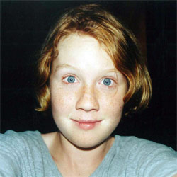
Aftermath
Sabrina’s EpiPen® was not on her during the reaction
It was in another area of the school in her locker
Why do you think it wasn’t with her?

Slide 7
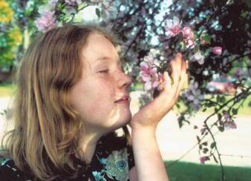
Bullying
Sabrina did not have her EpiPen® with her
Do you think it could have been due to embarrassment or teasing/bullying over her allergies?
How could bullying affect someone with food allergies?

Slide 8
Discussion
What can we learn from this tragedy?
How could Sabrina’s tragedy have been prevented?
What would you have done as a bystander?
How can you support your friend with food allergies while eating out?
How can we make our school a safe and inclusive place for everyone?

