Slide 1
Let’s Get Allergy Aware!
Primary (Grades 1-3)

Slide 2
Let’s Get Allergy Aware!
Respecting Differences
Common Allergens
Inclusion
Hand Washing
Healthy Food Choices
Signs & Symptoms
Epinephrine Auto-Injectors (e.g. EpiPen®)

Slide 3
1. Respecting Differences
Notes:
Topic 1: Respecting Differences
Objectives:
Understand the things that can make us different
Physical (e.g., appearances)
Emotional (e.g., feelings)
Health (e.g., conditions)
Know that all differences are okay and make us unique
Suggested Materials: “Differences” Colouring Sheet, Follow the Pattern
Activity: Discussion
Questions and Explanations:
Can you name one thing that we all have in common?
We all have ears, eyes, noses etc.
What’s something that makes us different from each other?
Appearances (hair/eye colour, glasses)
Family from another country
Hobbies
Health
Is it okay to be different?
Ask children to put up their hands for different categories to show that we’re all different (e.g. “Who has green eyes? Blue eyes? Brown eyes?”). Should we ever make fun or tease someone for being different? No. We’re all different in so many ways, so we should never make fun of those differences. Some of us have different bodies and health issues. Some people can’t eat the same foods as everybody else.
Do you know what it’s called when certain foods make someone sick?
Food allergies. People with food allergies are different because they can’t eat all of the same foods as everybody else. They can get very sick by eating foods they’re allergic to. Some people are allergic to peanuts, nuts, milk or many other foods.
Do you know somebody with a food allergy?
Did you know there are students in our class/school that have food allergies? We can all help them stay safe!

Slide 4
Respecting Differences
Can you name one thing that we all have in common?
What’s something that makes us all different?
Notes:
Topic 1: Respecting Differences
Objectives:
Understand the things that can make us different
Physical (e.g., appearances)
Emotional (e.g., feelings)
Health (e.g., conditions)
Know that all differences are okay and make us unique
Suggested Materials: “Differences” Colouring Sheet, Follow the Pattern
Activity: Discussion
Questions and Explanations:
Can you name one thing that we all have in common?
We all have ears, eyes, noses etc.
What’s something that makes us different from each other?
Appearances (hair/eye colour, glasses)
Family from another country
Hobbies
Health
Is it okay to be different?
Ask children to put up their hands for different categories to show that we’re all different (e.g. “Who has green eyes? Blue eyes? Brown eyes?”). Should we ever make fun or tease someone for being different? No. We’re all different in so many ways, so we should never make fun of those differences. Some of us have different bodies and health issues. Some people can’t eat the same foods as everybody else.
Do you know what it’s called when certain foods make someone sick?
Food allergies. People with food allergies are different because they can’t eat all of the same foods as everybody else. They can get very sick by eating foods they’re allergic to. Some people are allergic to peanuts, nuts, milk or many other foods.
Do you know somebody with a food allergy?
Did you know there are students in our class/school that have food allergies? We can all help them stay safe!

Slide 5
Respecting Differences
Is it okay to be different?
Why are differences a good thing?
Why do food allergies make someone different?
Do you know someone with a food allergy?
What do you think it would be like to have a food allergy?
Notes:
Topic 1: Respecting Differences
Objectives:
Understand the things that can make us different
Physical (e.g., appearances)
Emotional (e.g., feelings)
Health (e.g., conditions)
Know that all differences are okay and make us unique
Suggested Materials: “Differences” Colouring Sheet, Follow the Pattern
Activity: Discussion
Questions and Explanations:
Can you name one thing that we all have in common?
We all have ears, eyes, noses etc.
What’s something that makes us different from each other?
Appearances (hair/eye colour, glasses)
Family from another country
Hobbies
Health
Is it okay to be different?
Ask children to put up their hands for different categories to show that we’re all different (e.g. “Who has green eyes? Blue eyes? Brown eyes?”). Should we ever make fun or tease someone for being different? No. We’re all different in so many ways, so we should never make fun of those differences. Some of us have different bodies and health issues. Some people can’t eat the same foods as everybody else.
Do you know what it’s called when certain foods make someone sick?
Food allergies. People with food allergies are different because they can’t eat all of the same foods as everybody else. They can get very sick by eating foods they’re allergic to. Some people are allergic to peanuts, nuts, milk or many other foods.
Do you know somebody with a food allergy?
Did you know there are students in our class/school that have food allergies? We can all help them stay safe!

Slide 6
2. Common Allergens
Notes:
Topic 2: Common Allergens
Objectives:
Learn what are the common allergens
To understand that there is more than just food that can cause a reaction
Reinforce which foods are safe/unsafe to have at school
Suggested Materials:
Connect the Allergens
Memory Flash Cards
Word Search
How Many Allergies?
Activity: Discussion
Questions and Explanations:
Do you know someone with an allergy?
What are they allergic to?
Why are food allergies so serious?
Because they can make people very sick. So sick that they might need to go to the hospital and need emergency services.
Is it possible to be allergic to more than peanuts and tree nuts?
Do you think people can be allergic to more than one thing at the same time?
What do you think the most common food allergies are?
Show pictures from Memory Flash Cards
Inform students that it’s more than food. People can also be allergic to insect stings, medicine and latex.
It’s important that we don’t bring ___________ (include any classroom food restrictions).
Some of our classmates have food allergies and we don’t want to make them sick.

Slide 7
Common Allergens
Do you know someone with a food allergy?
What are they allergic to?
Why are food allergies so serious?
Is it possible to be allergic to more than peanuts or tree nuts?
Notes:
Topic 2: Common Allergens
Objectives:
Learn what are the common allergens
To understand that there is more than just food that can cause a reaction
Reinforce which foods are safe/unsafe to have at school
Suggested Materials:
Connect the Allergens
Memory Flash Cards
Word Search
How Many Allergies?
Activity: Discussion
Questions and Explanations:
Do you know someone with an allergy?
What are they allergic to?
Why are food allergies so serious?
Because they can make people very sick. So sick that they might need to go to the hospital and need emergency services.
Is it possible to be allergic to more than peanuts and tree nuts?
Do you think people can be allergic to more than one thing at the same time?
What do you think the most common food allergies are?
Show pictures from Memory Flash Cards
Inform students that it’s more than food. People can also be allergic to insect stings, medicine and latex.
It’s important that we don’t bring ___________ (include any classroom food restrictions).
Some of our classmates have food allergies and we don’t want to make them sick.

Slide 8
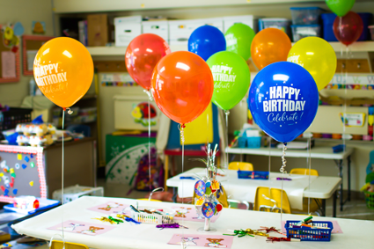
Common Allergens
What are the foods that we don’t bring into our classroom?
Notes:
Topic 2: Common Allergens
Objectives:
Learn what are the common allergens
To understand that there is more than just food that can cause a reaction
Reinforce which foods are safe/unsafe to have at school
Suggested Materials:
Connect the Allergens
Memory Flash Cards
Word Search
How Many Allergies?
Activity: Discussion
Questions and Explanations:
Do you know someone with an allergy?
What are they allergic to?
Why are food allergies so serious?
Because they can make people very sick. So sick that they might need to go to the hospital and need emergency services.
Is it possible to be allergic to more than peanuts and tree nuts?
Do you think people can be allergic to more than one thing at the same time?
What do you think the most common food allergies are?
Show pictures from Memory Flash Cards
Inform students that it’s more than food. People can also be allergic to insect stings, medicine and latex.
It’s important that we don’t bring ___________ (include any classroom food restrictions).
Some of our classmates have food allergies and we don’t want to make them sick.

Slide 9
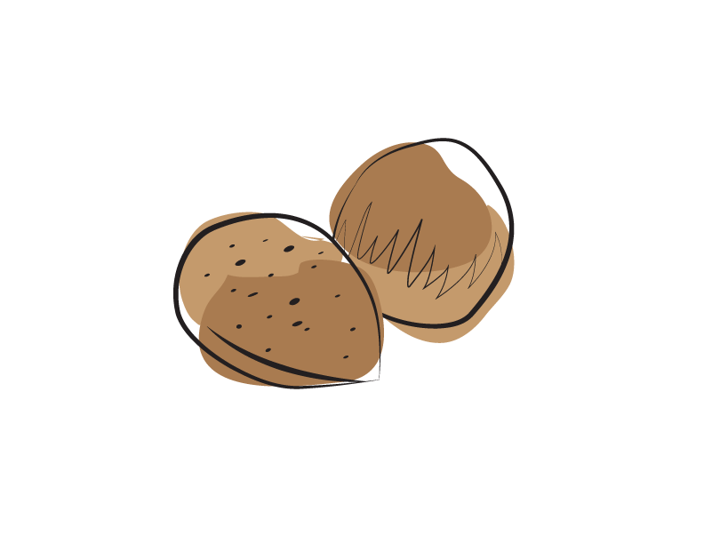
Common Allergens
What are these foods?
Soy
Egg
Milk
Mustard
Tree Nut
Peanut
Seafood
(fish, shellfish, crustaceans)
Sesame
Wheat
Sulphites
Notes:
Topic 2: Common Allergens
Objectives:
Learn what are the common allergens
To understand that there is more than just food that can cause a reaction
Reinforce which foods are safe/unsafe to have at school
Suggested Materials:
Connect the Allergens
Memory Flash Cards
Word Search
How Many Allergies?
Activity: Discussion
Questions and Explanations:
Do you know someone with an allergy?
What are they allergic to?
Why are food allergies so serious?
Because they can make people very sick. So sick that they might need to go to the hospital and need emergency services.
Is it possible to be allergic to more than peanuts and tree nuts?
Do you think people can be allergic to more than one thing at the same time?
What do you think the most common food allergies are?
Show pictures from Memory Flash Cards
Inform students that it’s more than food. People can also be allergic to insect stings, medicine and latex.
It’s important that we don’t bring ___________ (include any classroom food restrictions).
Some of our classmates have food allergies and we don’t want to make them sick.

Slide 10
3. Inclusion
Notes:
Topic 3: Inclusion
Objectives:
To develop a sense of empathy for those who have food allergies
To realize that living with a food allergy can be difficult and that support is needed
Remember that everybody should be included no matter their differences
Suggested Materials:
“May Contain Peanuts/Nuts”
What’s Safe for Lunch
What’s Safe for Jerome
Colouring Sheets (Differnces, Hand Washing, No Sharing Food)
Activity: Discussion
Questions and Explanations:
Do people choose to have food allergies?
Remind students that we’re all different and that we never make fun or tease someone for their differences.
No one knows why people have food allergies. There is no cure for them, which is why we all need to take them seriously and help others stay safe.
How would you feel if you were unable to eat one of your favourite foods?
How would you feel at a birthday party if you were unable to eat the birthday cake?
What can we do at birthday parties or celebrations to make sure everybody is included?
Make sure we invite everyone
Include everyone in games
Wash our hands
Not share food
Instead of having a celebration where everyone receives food, what could we give out instead?
Ideas could be stickers, pencils etc.
Opportunity to remind about classroom celebration policies.

Slide 11
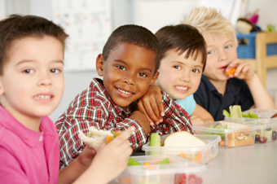
Inclusion
Do people choose to have food allergies?
How would you feel if you were unable to eat one of the foods you love most?
Notes:
Topic 3: Inclusion
Objectives:
To develop a sense of empathy for those who have food allergies
To realize that living with a food allergy can be difficult and that support is needed
Remember that everybody should be included no matter their differences
Suggested Materials:
“May Contain Peanuts/Nuts”
What’s Safe for Lunch
What’s Safe for Jerome
Colouring Sheets (Differnces, Hand Washing, No Sharing Food)
Activity: Discussion
Questions and Explanations:
Do people choose to have food allergies?
Remind students that we’re all different and that we never make fun or tease someone for their differences.
No one knows why people have food allergies. There is no cure for them, which is why we all need to take them seriously and help others stay safe.
How would you feel if you were unable to eat one of your favourite foods?
How would you feel at a birthday party if you were unable to eat the birthday cake?
What can we do at birthday parties or celebrations to make sure everybody is included?
Make sure we invite everyone
Include everyone in games
Wash our hands
Not share food
Instead of having a celebration where everyone receives food, what could we give out instead?
Ideas could be stickers, pencils etc.
Opportunity to remind about classroom celebration policies.

Slide 12
Inclusion
What can we do at birthday parties or celebrations to make sure everyone is included?
Instead of having a celebration where everyone receives food, what could we give out instead?
Notes:
Topic 3: Inclusion
Objectives:
To develop a sense of empathy for those who have food allergies
To realize that living with a food allergy can be difficult and that support is needed
Remember that everybody should be included no matter their differences
Suggested Materials:
“May Contain Peanuts/Nuts”
What’s Safe for Lunch
What’s Safe for Jerome
Colouring Sheets (Differnces, Hand Washing, No Sharing Food)
Activity: Discussion
Questions and Explanations:
Do people choose to have food allergies?
Remind students that we’re all different and that we never make fun or tease someone for their differences.
No one knows why people have food allergies. There is no cure for them, which is why we all need to take them seriously and help others stay safe.
How would you feel if you were unable to eat one of your favourite foods?
How would you feel at a birthday party if you were unable to eat the birthday cake?
What can we do at birthday parties or celebrations to make sure everybody is included?
Make sure we invite everyone
Include everyone in games
Wash our hands
Not share food
Instead of having a celebration where everyone receives food, what could we give out instead?
Ideas could be stickers, pencils etc.
Opportunity to remind about classroom celebration policies.

Slide 13
4. Hand Washing
Notes:
Topic 4: Hand-Washing - Glitter Experiment
Objectives:
How, when and why we wash our hands
Enforcing the routine and importance of washing hands before and after meals
Suggested Materials:
Glitter
A bowl of water
Soap
Hand sanitizer
Paper towel
Hand Washing Colouring Sheet
Activity: Demonstration with a few students in the front of the class
Questions and Explanations:
What do you think is better at getting rid of food off of our hands? Soap and water, or hand sanitizer?
Let’s do an experiment to find out!
Ask 4-6 volunteers come to the front of the class.
Instruct them to cover one of their hands in glitter.
Have all the volunteers shake each other’s clean hand with a glitter-filled hand to emphasize that every time we shake hands, the glitter is passed on.
Have a brainstorm session of what the glitter is representing (answer: dirt, germs or allergens).
Now allow each student to dip their hands in the bowl of water, but not to use soap or allow them to dry their hands. Emphasize the importance of washing your hands properly by pointing out how not all the glitter is gone from the students’ hands.
Next, ask them to rub hand sanitizer on their hands to see that the glitter is still not gone.
Now the students must wash their hands with soap and properly dry them with paper towel.
The instructor should emphasize how now all the glitter is gone and thank the volunteers.
Now brainstorm with students on when it is appropriate to wash your hands (before and after meals) to keep everyone safe and healthy.

Slide 14
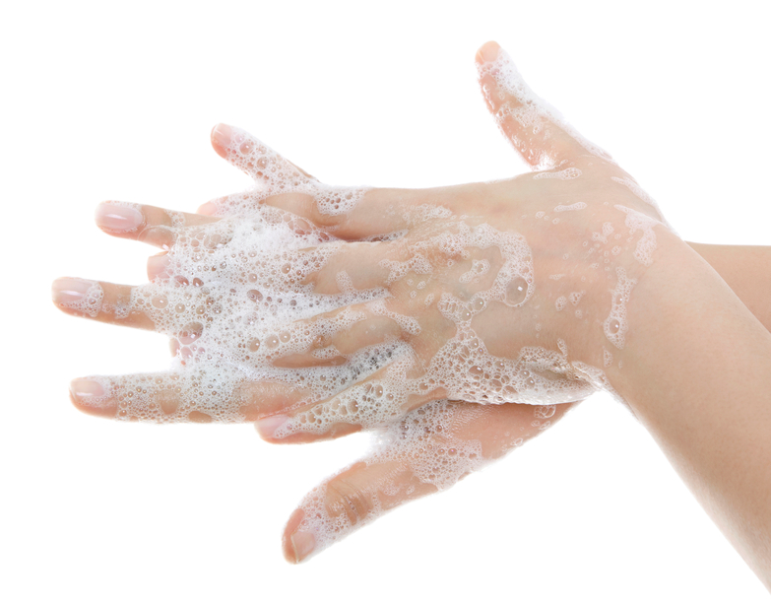
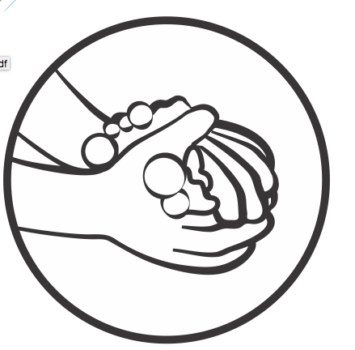
Hand Washing
Glitter experiment
What will work better at getting food (glitter) off our hands?
Soap or hand sanitizer?
Notes:
Topic 4: Hand-Washing - Glitter Experiment
Objectives:
How, when and why we wash our hands
Enforcing the routine and importance of washing hands before and after meals
Suggested Materials:
Glitter
A bowl of water
Soap
Hand sanitizer
Paper towel
Hand Washing Colouring Sheet
Activity: Demonstration with a few students in the front of the class
Questions and Explanations:
What do you think is better at getting rid of food off of our hands? Soap and water, or hand sanitizer?
Let’s do an experiment to find out!
Ask 4-6 volunteers come to the front of the class.
Instruct them to cover one of their hands in glitter.
Have all the volunteers shake each other’s clean hand with a glitter-filled hand to emphasize that every time we shake hands, the glitter is passed on.
Have a brainstorm session of what the glitter is representing (answer: dirt, germs or allergens).
Now allow each student to dip their hands in the bowl of water, but not to use soap or allow them to dry their hands. Emphasize the importance of washing your hands properly by pointing out how not all the glitter is gone from the students’ hands.
Next, ask them to rub hand sanitizer on their hands to see that the glitter is still not gone.
Now the students must wash their hands with soap and properly dry them with paper towel.
The instructor should emphasize how now all the glitter is gone and thank the volunteers.
Now brainstorm with students on when it is appropriate to wash your hands (before and after meals) to keep everyone safe and healthy.

Slide 15
5. Healthy Food Choices
Notes:
Topic 5: Healthy Food Choices
Objectives:
To understand how and what it means to maintain a well-balanced diet according to the Canada Food Guide
The importance of all food groups
How to make substitutions within the same food group if anyone is not able to eat a certain product in any food group
Enforcing the rule to never share food
Suggested Materials:
Canada Food Guide
Food Substitutes Worksheet
What’s Safe for Lunch Worksheet
Activity: Discussion
Questions and Explanations:
Do you know what the four main food groups are?
Introduce Canada’s Food Guide and all four food groups
Why is it important to eat a balanced diet from these four food groups?
Discuss the importance of healthy eating and getting proper nutrition to help with growth, energy and overall health.
What food groups would the following allergens be in?
Peanuts (meats & alternatives)
Milk (milk & alternatives)
Fish (meats & alternatives)
Wheat (grain products)
What should someone with food allergies do if they can’t eat certain foods that are considered healthy?
Find substitutes through the Canada Food Guide.
Why is it important that we never share food?
Remind students that although some foods are healthy and safe for some, they may not be for everyone. It’s best to keep our food to ourselves.

Slide 16
Healthy Food Choices
What are the four main food groups?
What could someone with food allergies do if they can’t eat certain foods?
Notes:
Topic 5: Healthy Food Choices
Objectives:
To understand how and what it means to maintain a well-balanced diet according to the Canada Food Guide
The importance of all food groups
How to make substitutions within the same food group if anyone is not able to eat a certain product in any food group
Enforcing the rule to never share food
Suggested Materials:
Canada Food Guide
Food Substitutes Worksheet
What’s Safe for Lunch Worksheet
Activity: Discussion
Questions and Explanations:
Do you know what the four main food groups are?
Introduce Canada’s Food Guide and all four food groups
Why is it important to eat a balanced diet from these four food groups?
Discuss the importance of healthy eating and getting proper nutrition to help with growth, energy and overall health.
What food groups would the following allergens be in?
Peanuts (meats & alternatives)
Milk (milk & alternatives)
Fish (meats & alternatives)
Wheat (grain products)
What should someone with food allergies do if they can’t eat certain foods that are considered healthy?
Find substitutes through the Canada Food Guide.
Why is it important that we never share food?
Remind students that although some foods are healthy and safe for some, they may not be for everyone. It’s best to keep our food to ourselves.

Slide 17
Healthy Food Choices
Can we share food at school?
Explain
Notes:
Topic 5: Healthy Food Choices
Objectives:
To understand how and what it means to maintain a well-balanced diet according to the Canada Food Guide
The importance of all food groups
How to make substitutions within the same food group if anyone is not able to eat a certain product in any food group
Enforcing the rule to never share food
Suggested Materials:
Canada Food Guide
Food Substitutes Worksheet
What’s Safe for Lunch Worksheet
Activity: Discussion
Questions and Explanations:
Do you know what the four main food groups are?
Introduce Canada’s Food Guide and all four food groups
Why is it important to eat a balanced diet from these four food groups?
Discuss the importance of healthy eating and getting proper nutrition to help with growth, energy and overall health.
What food groups would the following allergens be in?
Peanuts (meats & alternatives)
Milk (milk & alternatives)
Fish (meats & alternatives)
Wheat (grain products)
What should someone with food allergies do if they can’t eat certain foods that are considered healthy?
Find substitutes through the Canada Food Guide.
Why is it important that we never share food?
Remind students that although some foods are healthy and safe for some, they may not be for everyone. It’s best to keep our food to ourselves.

Slide 18
6. Signs & Symptoms
Notes:
Topic 6: Symptoms of an Allergic Reaction
Objectives:
Recognize the signs and symptoms of an allergic reaction
Tell the teacher or an adults if you, or someone else is having an emergency
Suggested Materials: Match the Symptoms
Activity: Discussion
Questions and Explanations:
Does anybody know what “symptoms” are?
Explain how symptoms are strange signs that we get on our bodies when we get sick.
That’s what happens to our bodies when we get a cold or the flu.
Are symptoms something we take seriously?
It’s important to take notice if we ever feel strange or unwell.
What do we do if we ever feel funny, or see someone else with strange signs or symptoms? Who should we tell?
What would happen if someone with food allergies ate something that they are allergic to?
They would get very sick with different symptoms
Swelling
Stomach cramps
Hives/rashes
Difficulty breathing
Sneezing
Dizziness
Where can these happen on the body?
How can we help prevent allergic reactions at school?
Allergic reactions are very serious and could send someone to the hospital. That’s why we don’t share food, wash our hands and take food allergies seriously. If we ever saw someone having strange symptoms, it’s important to speak up and tell an adult immediately.

Slide 19
Signs & Symptoms
What do symptoms mean?
Should we take them seriously?
What do we do if we ever felt symptoms?
Notes:
Topic 6: Symptoms of an Allergic Reaction
Objectives:
Recognize the signs and symptoms of an allergic reaction
Tell the teacher or an adults if you, or someone else is having an emergency
Suggested Materials: Match the Symptoms
Activity: Discussion
Questions and Explanations:
Does anybody know what “symptoms” are?
Explain how symptoms are strange signs that we get on our bodies when we get sick.
That’s what happens to our bodies when we get a cold or the flu.
Are symptoms something we take seriously?
It’s important to take notice if we ever feel strange or unwell.
What do we do if we ever feel funny, or see someone else with strange signs or symptoms? Who should we tell?
What would happen if someone with food allergies ate something that they are allergic to?
They would get very sick with different symptoms
Swelling
Stomach cramps
Hives/rashes
Difficulty breathing
Sneezing
Dizziness
Where can these happen on the body?
How can we help prevent allergic reactions at school?
Allergic reactions are very serious and could send someone to the hospital. That’s why we don’t share food, wash our hands and take food allergies seriously. If we ever saw someone having strange symptoms, it’s important to speak up and tell an adult immediately.

Slide 20
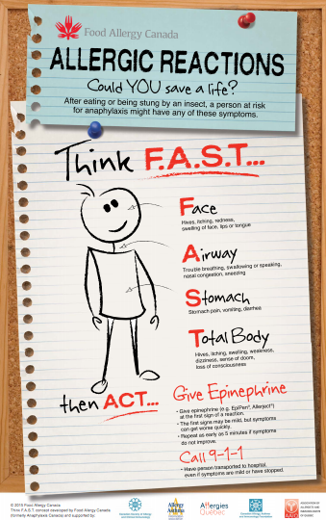
Signs & Symptoms
What symptoms can someone with a food allergy get?
Swelling
Stomach cramps
Hives/rashes
Sneezing
Dizziness
How can we prevent allergic reactions at school?
Notes:
Topic 6: Symptoms of an Allergic Reaction
Objectives:
Recognize the signs and symptoms of an allergic reaction
Tell the teacher or an adults if you, or someone else is having an emergency
Suggested Materials: Match the Symptoms
Activity: Discussion
Questions and Explanations:
Does anybody know what “symptoms” are?
Explain how symptoms are strange signs that we get on our bodies when we get sick.
That’s what happens to our bodies when we get a cold or the flu.
Are symptoms something we take seriously?
It’s important to take notice if we ever feel strange or unwell.
What do we do if we ever feel funny, or see someone else with strange signs or symptoms? Who should we tell?
What would happen if someone with food allergies ate something that they are allergic to?
They would get very sick with different symptoms
Swelling
Stomach cramps
Hives/rashes
Difficulty breathing
Sneezing
Dizziness
Where can these happen on the body?
How can we help prevent allergic reactions at school?
Allergic reactions are very serious and could send someone to the hospital. That’s why we don’t share food, wash our hands and take food allergies seriously. If we ever saw someone having strange symptoms, it’s important to speak up and tell an adult immediately.

Slide 21
7. Epinephrine Auto-Injectors
Notes:
Topic 7: Epinephrine Auto-Injectors
Objectives:
Introduction to auto-injectors and how they keep people safe
Inclusiveness in the classroom
Suggested Materials:
Safety Equipment Worksheet
Activity: Show and Tell, Discussion
Questions and Explanations:
*Prior to activity ask any student with allergies if they would like to share with the class their auto injector
Can you name any tools or devices that help keep you safe and protected?
Introduce safety devices through the pictures on worksheet (e.g., seatbelt, helmets) and brainstorm why we use them.
Why do we use special gear or equipment in certain situations?
Ask the students if they do any activities where they wear safety equipment.
Did you know people with food allergies have safety gear with them that can help them during an allergic reaction? In fact, we have students in our classroom with one.
Show an epinephrine auto-injector and explain that it is a special medicine that can help make an allergic reaction go away.
Ask a student with allergies where they keep it.
Should we ever play with one of these if we ever found one?
Explain that they are not toys. It is a very serious medicine that we should never play with or joke around about.
If someone used one, they would need to go to the hospital right away.
Remind students where they are kept in your classroom/school.
Is it okay to tease someone for having their medicine with them?
We all have differences and different ways of staying healthy and safe. It is important to accept and support each other’s differences, and never tease or make fun of each other.

Slide 22
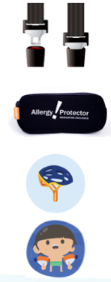
Epinephrine Auto-Injectors
Can you name any tools or devices that help keep you safe and protected?
When riding a bike?
When in a car?
When in a pool?
How can they help?
Notes:
Topic 7: Epinephrine Auto-Injectors
Objectives:
Introduction to auto-injectors and how they keep people safe
Inclusiveness in the classroom
Suggested Materials:
Safety Equipment Worksheet
Activity: Show and Tell, Discussion
Questions and Explanations:
*Prior to activity ask any student with allergies if they would like to share with the class their auto injector
Can you name any tools or devices that help keep you safe and protected?
Introduce safety devices through the pictures on worksheet (e.g., seatbelt, helmets) and brainstorm why we use them.
Why do we use special gear or equipment in certain situations?
Ask the students if they do any activities where they wear safety equipment.
Did you know people with food allergies have safety gear with them that can help them during an allergic reaction? In fact, we have students in our classroom with one.
Show an epinephrine auto-injector and explain that it is a special medicine that can help make an allergic reaction go away.
Ask a student with allergies where they keep it.
Should we ever play with one of these if we ever found one?
Explain that they are not toys. It is a very serious medicine that we should never play with or joke around about.
If someone used one, they would need to go to the hospital right away.
Remind students where they are kept in your classroom/school.
Is it okay to tease someone for having their medicine with them?
We all have differences and different ways of staying healthy and safe. It is important to accept and support each other’s differences, and never tease or make fun of each other.

Slide 23
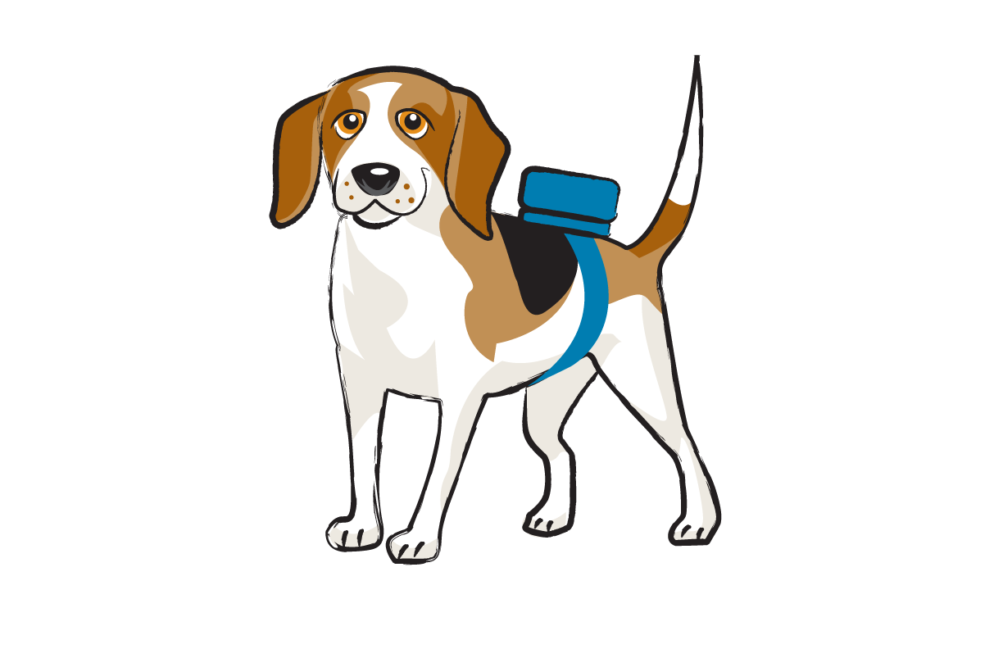
Epinephrine Auto-Injectors
Do you know people with allergies have safety gear too?
Do you know what it’s called?
An EpiPen®
Should we ever…
Play with one?
Joke about one?
Tease someone about one?
Notes:
Topic 7: Epinephrine Auto-Injectors
Objectives:
Introduction to auto-injectors and how they keep people safe
Inclusiveness in the classroom
Suggested Materials:
Safety Equipment Worksheet
Activity: Show and Tell, Discussion
Questions and Explanations:
*Prior to activity ask any student with allergies if they would like to share with the class their auto injector
Can you name any tools or devices that help keep you safe and protected?
Introduce safety devices through the pictures on worksheet (e.g., seatbelt, helmets) and brainstorm why we use them.
Why do we use special gear or equipment in certain situations?
Ask the students if they do any activities where they wear safety equipment.
Did you know people with food allergies have safety gear with them that can help them during an allergic reaction? In fact, we have students in our classroom with one.
Show an epinephrine auto-injector and explain that it is a special medicine that can help make an allergic reaction go away.
Ask a student with allergies where they keep it.
Should we ever play with one of these if we ever found one?
Explain that they are not toys. It is a very serious medicine that we should never play with or joke around about.
If someone used one, they would need to go to the hospital right away.
Remind students where they are kept in your classroom/school.
Is it okay to tease someone for having their medicine with them?
We all have differences and different ways of staying healthy and safe. It is important to accept and support each other’s differences, and never tease or make fun of each other.

Slide 24
Do you have any questions?

Slide 25
Activities

Slide 26
Activities
Worksheets
Thumbs Up Thumbs Down
Trivia game
What’s in That Food?

