Slide 1
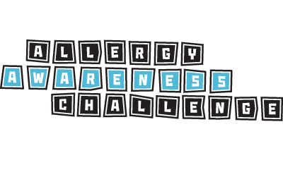
Know Allergies? Prove it!
Intermediate (Grades 7-8)

Slide 2
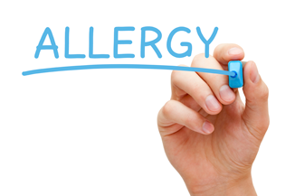
Allergy Awareness Challenge
Anaphylaxis
Common Allergens
Medical Identification
Cross-Contamination
Reading Ingredients
Signs & Symptoms
Epinephrine
Inclusion

Slide 3
1. Anaphylaxis
Notes:
Topic 1: What is Anaphylaxis?
Key Learning Points:
People with food allergies are just like everybody else, but have to avoid certain foods.
Many people have food allergies and that is normal.
Allergic reactions can be much more serious than environmental allergies/sneezing.
The immune system is responsible for allergic reactions.
People with serious food allergies can get very sick if they eat the foods that they are allergic to with a serious life-threatening allergic reaction called anaphylaxis. This would require hospitalization.
People can get allergies when they are young or old, and we don’t know why people get them, or lose them.
Suggested Materials: Food Allergy Spelling Bee
Activity: Discussion
Questions and Explanations
Do you know someone with a food allergy? What are they allergic to?
Help students understand that this is a problem that affects everyone (e.g. classmates, adults, siblings etc.).
Can you guess what anaphylaxis means?
It is a potentially life-threatening allergic reaction.
What do you think it would feel like to live with a life-threatening food allergy? What precautions would you need to take?
Why would food allergies be considered an “invisible disorder”
You cannot tell that a person has food allergies just by looking at them. It is a condition that does not affect your daily life. However, if you encounter one of their allergens, their immune system will release chemicals resulting in an allergic reaction.
Start a brainstorm on what systems of the body are responsible for what activities.
What system is responsible for breathing?
The respiratory system
What system is responsible for the blood circulating in the body?
The circulatory system
What system is responsible for digesting food?
The digestive system
What system is responsible for keeping us safe against disease and harmful bacteria?
The immune system
Why is the immune system important?
It helps us stay safe and healthy by identifying and fighting foreign intruders like germs and bacteria.
Why do you think the immune system is responsible for allergic reactions?
It treats certain foods as foreign invaders and releases histamine in an attempt to attack them. This results in symptoms of an allergic reaction or anaphylaxis.
How do you think people get food allergies and are they contagious?
Scientists do not exactly know why some people get food allergies and others do not. There is a lot of research being done to the cause of allergies, however there is currently no cure. Reiterate that this is why it is so important why we all learn how to help keep those with allergies safe.

Slide 4
Anaphylaxis
Do you know someone with an allergy?
What are they allergic to?
Can allergies be serious?
What do you think the word “anaphylaxis” means?
Notes:
Topic 1: What is Anaphylaxis?
Key Learning Points:
People with food allergies are just like everybody else, but have to avoid certain foods.
Many people have food allergies and that is normal.
Allergic reactions can be much more serious than environmental allergies/sneezing.
The immune system is responsible for allergic reactions.
People with serious food allergies can get very sick if they eat the foods that they are allergic to with a serious life-threatening allergic reaction called anaphylaxis. This would require hospitalization.
People can get allergies when they are young or old, and we don’t know why people get them, or lose them.
Suggested Materials: Food Allergy Spelling Bee
Activity: Discussion
Questions and Explanations
Do you know someone with a food allergy? What are they allergic to?
Help students understand that this is a problem that affects everyone (e.g. classmates, adults, siblings etc.).
Can you guess what anaphylaxis means?
It is a potentially life-threatening allergic reaction.
What do you think it would feel like to live with a life-threatening food allergy? What precautions would you need to take?
Why would food allergies be considered an “invisible disorder”
You cannot tell that a person has food allergies just by looking at them. It is a condition that does not affect your daily life. However, if you encounter one of their allergens, their immune system will release chemicals resulting in an allergic reaction.
Start a brainstorm on what systems of the body are responsible for what activities.
What system is responsible for breathing?
The respiratory system
What system is responsible for the blood circulating in the body?
The circulatory system
What system is responsible for digesting food?
The digestive system
What system is responsible for keeping us safe against disease and harmful bacteria?
The immune system
Why is the immune system important?
It helps us stay safe and healthy by identifying and fighting foreign intruders like germs and bacteria.
Why do you think the immune system is responsible for allergic reactions?
It treats certain foods as foreign invaders and releases histamine in an attempt to attack them. This results in symptoms of an allergic reaction or anaphylaxis.
How do you think people get food allergies and are they contagious?
Scientists do not exactly know why some people get food allergies and others do not. There is a lot of research being done to the cause of allergies, however there is currently no cure. Reiterate that this is why it is so important why we all learn how to help keep those with allergies safe.

Slide 5
Anaphylaxis
Anaphylaxis is a potentially life-threatening allergic reaction
What system in the body causes an anaphylactic reaction?
Immune system?
Respiratory system?
Digestive system?
Circulatory system?
Notes:
Topic 1: What is Anaphylaxis?
Key Learning Points:
People with food allergies are just like everybody else, but have to avoid certain foods.
Many people have food allergies and that is normal.
Allergic reactions can be much more serious than environmental allergies/sneezing.
The immune system is responsible for allergic reactions.
People with serious food allergies can get very sick if they eat the foods that they are allergic to with a serious life-threatening allergic reaction called anaphylaxis. This would require hospitalization.
People can get allergies when they are young or old, and we don’t know why people get them, or lose them.
Suggested Materials: Food Allergy Spelling Bee
Activity: Discussion
Questions and Explanations
Do you know someone with a food allergy? What are they allergic to?
Help students understand that this is a problem that affects everyone (e.g. classmates, adults, siblings etc.).
Can you guess what anaphylaxis means?
It is a potentially life-threatening allergic reaction.
What do you think it would feel like to live with a life-threatening food allergy? What precautions would you need to take?
Why would food allergies be considered an “invisible disorder”
You cannot tell that a person has food allergies just by looking at them. It is a condition that does not affect your daily life. However, if you encounter one of their allergens, their immune system will release chemicals resulting in an allergic reaction.
Start a brainstorm on what systems of the body are responsible for what activities.
What system is responsible for breathing?
The respiratory system
What system is responsible for the blood circulating in the body?
The circulatory system
What system is responsible for digesting food?
The digestive system
What system is responsible for keeping us safe against disease and harmful bacteria?
The immune system
Why is the immune system important?
It helps us stay safe and healthy by identifying and fighting foreign intruders like germs and bacteria.
Why do you think the immune system is responsible for allergic reactions?
It treats certain foods as foreign invaders and releases histamine in an attempt to attack them. This results in symptoms of an allergic reaction or anaphylaxis.
How do you think people get food allergies and are they contagious?
Scientists do not exactly know why some people get food allergies and others do not. There is a lot of research being done to the cause of allergies, however there is currently no cure. Reiterate that this is why it is so important why we all learn how to help keep those with allergies safe.

Slide 6
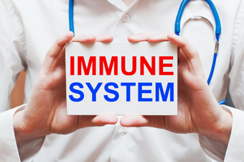
Anaphylaxis
The immune system keeps us healthy
Identifies and fights foreign intruders like germs and bacteria
How is the immune system is responsible for allergic reactions?
How do you think people get allergies?
Notes:
Topic 1: What is Anaphylaxis?
Key Learning Points:
People with food allergies are just like everybody else, but have to avoid certain foods.
Many people have food allergies and that is normal.
Allergic reactions can be much more serious than environmental allergies/sneezing.
The immune system is responsible for allergic reactions.
People with serious food allergies can get very sick if they eat the foods that they are allergic to with a serious life-threatening allergic reaction called anaphylaxis. This would require hospitalization.
People can get allergies when they are young or old, and we don’t know why people get them, or lose them.
Suggested Materials: Food Allergy Spelling Bee
Activity: Discussion
Questions and Explanations
Do you know someone with a food allergy? What are they allergic to?
Help students understand that this is a problem that affects everyone (e.g. classmates, adults, siblings etc.).
Can you guess what anaphylaxis means?
It is a potentially life-threatening allergic reaction.
What do you think it would feel like to live with a life-threatening food allergy? What precautions would you need to take?
Why would food allergies be considered an “invisible disorder”
You cannot tell that a person has food allergies just by looking at them. It is a condition that does not affect your daily life. However, if you encounter one of their allergens, their immune system will release chemicals resulting in an allergic reaction.
Start a brainstorm on what systems of the body are responsible for what activities.
What system is responsible for breathing?
The respiratory system
What system is responsible for the blood circulating in the body?
The circulatory system
What system is responsible for digesting food?
The digestive system
What system is responsible for keeping us safe against disease and harmful bacteria?
The immune system
Why is the immune system important?
It helps us stay safe and healthy by identifying and fighting foreign intruders like germs and bacteria.
Why do you think the immune system is responsible for allergic reactions?
It treats certain foods as foreign invaders and releases histamine in an attempt to attack them. This results in symptoms of an allergic reaction or anaphylaxis.
How do you think people get food allergies and are they contagious?
Scientists do not exactly know why some people get food allergies and others do not. There is a lot of research being done to the cause of allergies, however there is currently no cure. Reiterate that this is why it is so important why we all learn how to help keep those with allergies safe.

Slide 7
2. Common Allergens
Notes:
Topic 2: Common Allergens
Key Learning Points:
People can be allergic to many things, including foods, medicine, insect stings, and latex.
People can be allergic to more than one thing. Some have multiple allergies that are all serious.
Allergens can be ingredients in other foods (e.g. milk in butter).
Peanuts and tree nuts are separate allergens, as are fish and shellfish.
Introduce celiac disease as a condition where people cannot eat wheat.
Introduce lactose intolerance as a condition similar to a milk allergy, but with less severe symptoms and affecting the digestive system.
Suggested Materials: Name that Nut
Activity: Discussion
Questions and Explanations
What do you think the top 10 most common food allergies are in Canada?
Peanut, tree nut, egg, milk, seafood, soy, wheat, sesame, mustard and sulphites.
What’s the difference between a peanut and a tree nut?
They are two separate allergens. Someone can be allergic to one, but not the other. Unlike tree nuts, peanuts are classified as a legume.
Is lactose intolerance the same as a milk allergy?
Allergies affect a different system in the body – the immune system. Intolerances are generally associated with the digestive system and cause gastro-intestinal symptoms.
Other than food, what can people be allergic to?
Medicine, latex, environmental triggers, and insect stings.
Are peanuts the most serious allergy of all?
No, all allergens can be serious and cause anaphylaxis.
Is it possible to be allergic to exercise?
Not technically, however some people have what is called “exercise induced anaphylaxis” which is reaction caused by the combination of certain foods with exercise shortly afterwards.
What are the foods students are allergic to at our school? What rules do we have in place to help keep everyone with allergies safe?

Slide 8
Common Allergens
What do you think the top 10 most common food allergies are in Canada?
Notes:
Topic 2: Common Allergens
Key Learning Points:
People can be allergic to many things, including foods, medicine, insect stings, and latex.
People can be allergic to more than one thing. Some have multiple allergies that are all serious.
Allergens can be ingredients in other foods (e.g. milk in butter).
Peanuts and tree nuts are separate allergens, as are fish and shellfish.
Introduce celiac disease as a condition where people cannot eat wheat.
Introduce lactose intolerance as a condition similar to a milk allergy, but with less severe symptoms and affecting the digestive system.
Suggested Materials: Name that Nut
Activity: Discussion
Questions and Explanations
What do you think the top 10 most common food allergies are in Canada?
Peanut, tree nut, egg, milk, seafood, soy, wheat, sesame, mustard and sulphites.
What’s the difference between a peanut and a tree nut?
They are two separate allergens. Someone can be allergic to one, but not the other. Unlike tree nuts, peanuts are classified as a legume.
Is lactose intolerance the same as a milk allergy?
Allergies affect a different system in the body – the immune system. Intolerances are generally associated with the digestive system and cause gastro-intestinal symptoms.
Other than food, what can people be allergic to?
Medicine, latex, environmental triggers, and insect stings.
Are peanuts the most serious allergy of all?
No, all allergens can be serious and cause anaphylaxis.
Is it possible to be allergic to exercise?
Not technically, however some people have what is called “exercise induced anaphylaxis” which is reaction caused by the combination of certain foods with exercise shortly afterwards.
What are the foods students are allergic to at our school? What rules do we have in place to help keep everyone with allergies safe?

Slide 9
Common Allergens
Soy
Egg
Milk
Mustard
Tree Nut
Peanut
Seafood
(fish, shellfish, crustaceans)
Sesame
Wheat
Sulphites
Notes:
Topic 2: Common Allergens
Key Learning Points:
People can be allergic to many things, including foods, medicine, insect stings, and latex.
People can be allergic to more than one thing. Some have multiple allergies that are all serious.
Allergens can be ingredients in other foods (e.g. milk in butter).
Peanuts and tree nuts are separate allergens, as are fish and shellfish.
Introduce celiac disease as a condition where people cannot eat wheat.
Introduce lactose intolerance as a condition similar to a milk allergy, but with less severe symptoms and affecting the digestive system.
Suggested Materials: Name that Nut
Activity: Discussion
Questions and Explanations
What do you think the top 10 most common food allergies are in Canada?
Peanut, tree nut, egg, milk, seafood, soy, wheat, sesame, mustard and sulphites.
What’s the difference between a peanut and a tree nut?
They are two separate allergens. Someone can be allergic to one, but not the other. Unlike tree nuts, peanuts are classified as a legume.
Is lactose intolerance the same as a milk allergy?
Allergies affect a different system in the body – the immune system. Intolerances are generally associated with the digestive system and cause gastro-intestinal symptoms.
Other than food, what can people be allergic to?
Medicine, latex, environmental triggers, and insect stings.
Are peanuts the most serious allergy of all?
No, all allergens can be serious and cause anaphylaxis.
Is it possible to be allergic to exercise?
Not technically, however some people have what is called “exercise induced anaphylaxis” which is reaction caused by the combination of certain foods with exercise shortly afterwards.
What are the foods students are allergic to at our school? What rules do we have in place to help keep everyone with allergies safe?

Slide 10
Common Allergens
Are peanuts and tree nuts the same thing?
Is lactose intolerance the same as a milk allergy?
Other than food, what are other allergens?
Can exercise be a problem for some?
Are peanuts the most serious of all?
What rules do we have at school to keep everyone with allergies safe?
Notes:
Topic 2: Common Allergens
Key Learning Points:
People can be allergic to many things, including foods, medicine, insect stings, and latex.
People can be allergic to more than one thing. Some have multiple allergies that are all serious.
Allergens can be ingredients in other foods (e.g. milk in butter).
Peanuts and tree nuts are separate allergens, as are fish and shellfish.
Introduce celiac disease as a condition where people cannot eat wheat.
Introduce lactose intolerance as a condition similar to a milk allergy, but with less severe symptoms and affecting the digestive system.
Suggested Materials: Name that Nut
Activity: Discussion
Questions and Explanations
What do you think the top 10 most common food allergies are in Canada?
Peanut, tree nut, egg, milk, seafood, soy, wheat, sesame, mustard and sulphites.
What’s the difference between a peanut and a tree nut?
They are two separate allergens. Someone can be allergic to one, but not the other. Unlike tree nuts, peanuts are classified as a legume.
Is lactose intolerance the same as a milk allergy?
Allergies affect a different system in the body – the immune system. Intolerances are generally associated with the digestive system and cause gastro-intestinal symptoms.
Other than food, what can people be allergic to?
Medicine, latex, environmental triggers, and insect stings.
Are peanuts the most serious allergy of all?
No, all allergens can be serious and cause anaphylaxis.
Is it possible to be allergic to exercise?
Not technically, however some people have what is called “exercise induced anaphylaxis” which is reaction caused by the combination of certain foods with exercise shortly afterwards.
What are the foods students are allergic to at our school? What rules do we have in place to help keep everyone with allergies safe?

Slide 11
3. Medical Identification
Notes:
Topic 3 - Medical Identification
Key Learning Points:
Medical bracelets can be used to show what someone is allergic to.
In addition, they are used to show other health conditions (diabetes, asthma, epilepsy).
They come in different shapes and styles.
They are important to wear at all times if you have allergies.
People can have trouble breathing and speaking during an allergic reaction, which is why medical bracelets can be so important.
Suggested Materials: Discussion
Activity: Discussion and visit www.medicalert.ca
Visit www.medicalert.ca - show the students the different bracelets available and learn about the importance of them for various conditions.
Questions and Explanations
Why is medical bracelet important for someone with food allergies?
Severe symptoms may prevent them from telling someone what is wrong. (e.g. difficulty breathing/speaking). Paramedics are trained to look for medical identification during an emergency.
In what situations would this bracelet be particularly useful?
Examples could be: with others who aren’t aware of your allergies, travelling, and when alone. However, it’s important that they always be worn.
What other health conditions can be shown on a medical bracelet?
Diabetes, asthma, epilepsy are a few examples.
If you were to design your own bracelet, what would it look like?

Slide 12
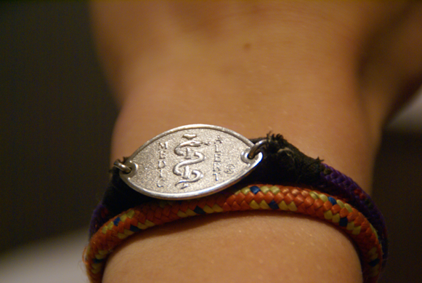
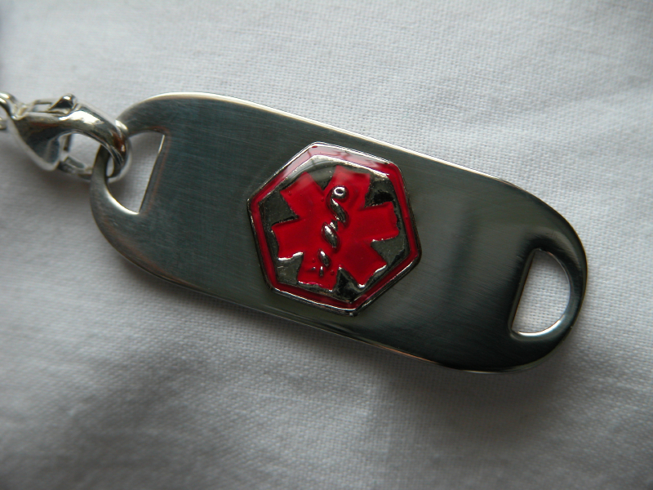
Medical Identification
What would be written on a medical bracelet/necklace?
Is it just for food allergies?
What other health conditions is it useful for?
How could it help someone with food allergies?
Notes:
Topic 3 - Medical Identification
Key Learning Points:
Medical bracelets can be used to show what someone is allergic to.
In addition, they are used to show other health conditions (diabetes, asthma, epilepsy).
They come in different shapes and styles.
They are important to wear at all times if you have allergies.
People can have trouble breathing and speaking during an allergic reaction, which is why medical bracelets can be so important.
Suggested Materials: Discussion
Activity: Discussion and visit www.medicalert.ca
Visit www.medicalert.ca - show the students the different bracelets available and learn about the importance of them for various conditions.
Questions and Explanations
Why is medical bracelet important for someone with food allergies?
Severe symptoms may prevent them from telling someone what is wrong. (e.g. difficulty breathing/speaking). Paramedics are trained to look for medical identification during an emergency.
In what situations would this bracelet be particularly useful?
Examples could be: with others who aren’t aware of your allergies, travelling, and when alone. However, it’s important that they always be worn.
What other health conditions can be shown on a medical bracelet?
Diabetes, asthma, epilepsy are a few examples.
If you were to design your own bracelet, what would it look like?

Slide 13
4. Cross-Contamination
Notes:
Topic 4: Cross-Contamination
Key Learning Points:
Remember the foods that are okay/not okay for our classroom.
Washing our hands with soap and water is best for getting food off – not hand sanitizer.
Knowing what cross-contamination is, and how it can be avoided (washing hands, keeping food on own plates/trays).
Know that food crumbs are not only on hands, but also on desks, trays and even on our faces.
Food is always meant to stay in the room where we eat lunch.
Suggested Materials: What is Cross-Contamination Worksheet
Activity: Discussion
Questions and Explanations
What do you think cross-contamination is?
Cross-contamination can happen when a small amount of a food allergen gets into another food accidentally, or when it is present in saliva, on a surface or on an object. This small amount of an allergen could cause an allergic reaction.
Can you think of examples where this could happen?
Examples could be: buffet with shared tongs, a knife being used for both peanut butter and jam, shared cutting boards, an allergen being scraped off (e.g. nuts off a salad or mayonnaise off of toast)
Should we wash our hands before, or after we eat? Or both? Why?
Optimal is both before and after eating to keep ourselves, and others safe and healthy.
Should we wash our hands with hand sanitizer or soap and water?
It’s been proven that soap and water is best at getting food proteins off of our hands.
Why should we always eat our food in the room we eat lunch?
We do not want food crumbs in places we expect to be safe (e.g. the classroom or gymnasium)
Why should we never share food at school?
It’s difficult to know what is in our food. What’s safe for one person may not be safe for another, thus our food should be kept to ourselves.

Slide 14
Cross-Contamination
What is cross-contamination?
What could be some examples?
Why do we follow key rules like:
Washing hands with soap
Keeping food to ourselves
Notes:
Topic 4: Cross-Contamination
Key Learning Points:
Remember the foods that are okay/not okay for our classroom.
Washing our hands with soap and water is best for getting food off – not hand sanitizer.
Knowing what cross-contamination is, and how it can be avoided (washing hands, keeping food on own plates/trays).
Know that food crumbs are not only on hands, but also on desks, trays and even on our faces.
Food is always meant to stay in the room where we eat lunch.
Suggested Materials: What is Cross-Contamination Worksheet
Activity: Discussion
Questions and Explanations
What do you think cross-contamination is?
Cross-contamination can happen when a small amount of a food allergen gets into another food accidentally, or when it is present in saliva, on a surface or on an object. This small amount of an allergen could cause an allergic reaction.
Can you think of examples where this could happen?
Examples could be: buffet with shared tongs, a knife being used for both peanut butter and jam, shared cutting boards, an allergen being scraped off (e.g. nuts off a salad or mayonnaise off of toast)
Should we wash our hands before, or after we eat? Or both? Why?
Optimal is both before and after eating to keep ourselves, and others safe and healthy.
Should we wash our hands with hand sanitizer or soap and water?
It’s been proven that soap and water is best at getting food proteins off of our hands.
Why should we always eat our food in the room we eat lunch?
We do not want food crumbs in places we expect to be safe (e.g. the classroom or gymnasium)
Why should we never share food at school?
It’s difficult to know what is in our food. What’s safe for one person may not be safe for another, thus our food should be kept to ourselves.

Slide 15
5. Reading Ingredients
Notes:
Topic 5: Reading Ingredients
Key Learning Points:
Learn the different types of information that product labels contain.
Know that ingredient lists are where you can find out what’s in your food.
A peanut free logo doesn’t cover a tree nut allergy or other allergens.
Products that say “may contain” products are not worth the risk.
Suggested Materials: Ingredient List Detective
Activity: Discussion & “Check a Label” Activity:
Check a Label: Ask children to find a product at home with at least two common allergens on the ingredient list. Ask them to report what the product was, and what common allergens were inside.
Questions and Explanations
What are examples of things you would find on a product label (e.g. a box of cookies).
Nutritional info, ingredient list, “best before” date.
Have you ever read an ingredient list before? Are they easy to read?
Does a peanut free logo on a package mean it’s okay for anyone to eat with a peanut and tree nut allergy?
No, remember that tree nut allergy is different than a peanut allergy. People can be allergic to one or the other, or both.
Who would someone with allergies talk to if they wanted to get a safe meal at a restaurant? What type of questions would they ask?
They could ask the wait staff, chef, or manager questions such as “do you know if this meal contains “x”, or would there be a chance cross-contamination could occur in the kitchen?
What do you think would be all of the ingredients in a pizza? Are there any common allergens in it?
Wheat, dairy, possibly seafood.
When a product says, “may contain” an allergen, why do you think it is not worth the risk for someone with food allergies to eat?
Unless you call the manufacturer directly, it’s hard to know what the level of risk would be. It’s best to not take the chance. When in doubt, do without.
Don’t make assumptions about food as it’s difficult to know what exactly is inside.

Slide 16
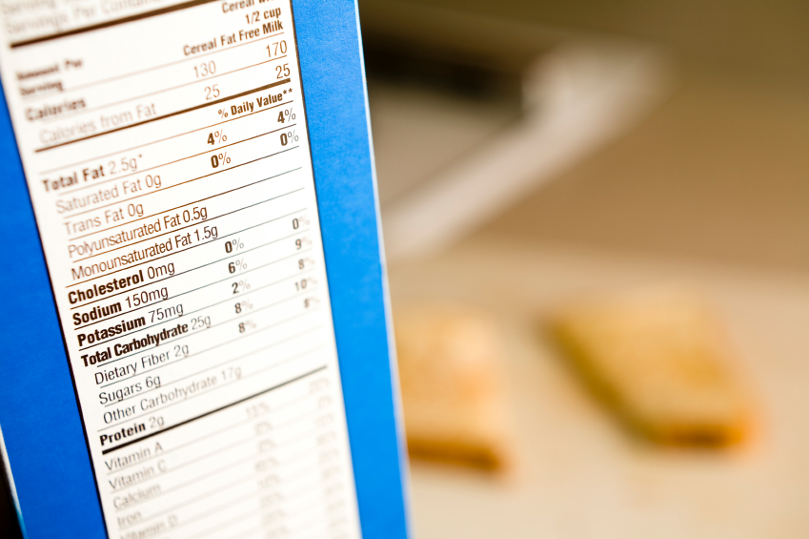
Reading Ingredients
Are ingredient lists easy to read?
What does a peanut-free logo mean?
Is it safe for someone with a tree nut allergy?
Would a product saying “May Contain” be safe?
What would someone with allergies do:
At a restaurant?
At a birthday party?
Notes:
Topic 5: Reading Ingredients
Key Learning Points:
Learn the different types of information that product labels contain.
Know that ingredient lists are where you can find out what’s in your food.
A peanut free logo doesn’t cover a tree nut allergy or other allergens.
Products that say “may contain” products are not worth the risk.
Suggested Materials: Ingredient List Detective
Activity: Discussion & “Check a Label” Activity:
Check a Label: Ask children to find a product at home with at least two common allergens on the ingredient list. Ask them to report what the product was, and what common allergens were inside.
Questions and Explanations
What are examples of things you would find on a product label (e.g. a box of cookies).
Nutritional info, ingredient list, “best before” date.
Have you ever read an ingredient list before? Are they easy to read?
Does a peanut free logo on a package mean it’s okay for anyone to eat with a peanut and tree nut allergy?
No, remember that tree nut allergy is different than a peanut allergy. People can be allergic to one or the other, or both.
Who would someone with allergies talk to if they wanted to get a safe meal at a restaurant? What type of questions would they ask?
They could ask the wait staff, chef, or manager questions such as “do you know if this meal contains “x”, or would there be a chance cross-contamination could occur in the kitchen?
What do you think would be all of the ingredients in a pizza? Are there any common allergens in it?
Wheat, dairy, possibly seafood.
When a product says, “may contain” an allergen, why do you think it is not worth the risk for someone with food allergies to eat?
Unless you call the manufacturer directly, it’s hard to know what the level of risk would be. It’s best to not take the chance. When in doubt, do without.
Don’t make assumptions about food as it’s difficult to know what exactly is inside.

Slide 17
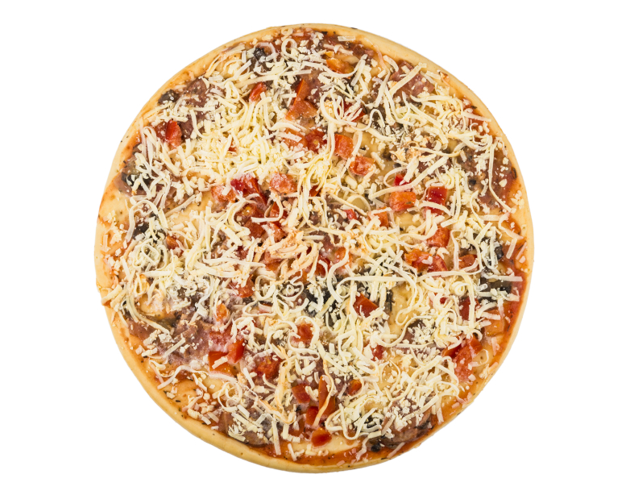
Reading Ingredients
What are potential allergens within a pizza?
Notes:
Topic 5: Reading Ingredients
Key Learning Points:
Learn the different types of information that product labels contain.
Know that ingredient lists are where you can find out what’s in your food.
A peanut free logo doesn’t cover a tree nut allergy or other allergens.
Products that say “may contain” products are not worth the risk.
Suggested Materials: Ingredient List Detective
Activity: Discussion & “Check a Label” Activity:
Check a Label: Ask children to find a product at home with at least two common allergens on the ingredient list. Ask them to report what the product was, and what common allergens were inside.
Questions and Explanations
What are examples of things you would find on a product label (e.g. a box of cookies).
Nutritional info, ingredient list, “best before” date.
Have you ever read an ingredient list before? Are they easy to read?
Does a peanut free logo on a package mean it’s okay for anyone to eat with a peanut and tree nut allergy?
No, remember that tree nut allergy is different than a peanut allergy. People can be allergic to one or the other, or both.
Who would someone with allergies talk to if they wanted to get a safe meal at a restaurant? What type of questions would they ask?
They could ask the wait staff, chef, or manager questions such as “do you know if this meal contains “x”, or would there be a chance cross-contamination could occur in the kitchen?
What do you think would be all of the ingredients in a pizza? Are there any common allergens in it?
Wheat, dairy, possibly seafood.
When a product says, “may contain” an allergen, why do you think it is not worth the risk for someone with food allergies to eat?
Unless you call the manufacturer directly, it’s hard to know what the level of risk would be. It’s best to not take the chance. When in doubt, do without.
Don’t make assumptions about food as it’s difficult to know what exactly is inside.

Slide 18
6. Signs & Symptoms
Notes:
Topic 6: Symptoms of an Allergic Reaction
Key Learning Points:
Learn that allergic reactions are very serious, potentially resulting in anaphylaxis.
Recognize the different symptoms of an allergic reaction.
When someone gets sick with an allergic reaction, it’s an emergency.
Speak up and get and adult right away.
Support your friends with allergies to tell you – not to keep it a secret.
Find out where their medicine is.
Suggested Materials: Symptoms of an Allergic Reaction
Activity: Discussion
Questions and Explanations
Have you ever had, or seen someone have an allergic reaction? What did you do?
What are some of the signs of an allergic reaction?
Cover all of the signs and symptoms with this hand “Think FAST” chart:
Who could you tell if you saw someone feeling really sick and needed help?
Why should you never keep an allergic reaction a secret? Why do you think someone might feel tempted to not tell anyone and go off alone?
Remind students that reactions worsen quickly and it’s important to get help from an adult right away.
Sometimes people might feel embarrassed if they are experiencing all of these strange symptoms. They also may not want to feel like a burden by asking for help from others. Always encourage your friends with allergies to tell you if they ever feel symptoms.
What phone number would you call in an emergency? What would you say on the phone?
911. Paramedics recommend that you use the word “anaphylaxis” on the phone so they are prepared when arriving at the scene.

Slide 19
Signs & Symptoms
Have you ever seen someone have an allergic reaction?
What are the symptoms that can happen?
What would you do in a food allergy emergency?
As a bystander
As someone having a reaction
Notes:
Topic 6: Symptoms of an Allergic Reaction
Key Learning Points:
Learn that allergic reactions are very serious, potentially resulting in anaphylaxis.
Recognize the different symptoms of an allergic reaction.
When someone gets sick with an allergic reaction, it’s an emergency.
Speak up and get and adult right away.
Support your friends with allergies to tell you – not to keep it a secret.
Find out where their medicine is.
Suggested Materials: Symptoms of an Allergic Reaction
Activity: Discussion
Questions and Explanations
Have you ever had, or seen someone have an allergic reaction? What did you do?
What are some of the signs of an allergic reaction?
Cover all of the signs and symptoms with this hand “Think FAST” chart:
Who could you tell if you saw someone feeling really sick and needed help?
Why should you never keep an allergic reaction a secret? Why do you think someone might feel tempted to not tell anyone and go off alone?
Remind students that reactions worsen quickly and it’s important to get help from an adult right away.
Sometimes people might feel embarrassed if they are experiencing all of these strange symptoms. They also may not want to feel like a burden by asking for help from others. Always encourage your friends with allergies to tell you if they ever feel symptoms.
What phone number would you call in an emergency? What would you say on the phone?
911. Paramedics recommend that you use the word “anaphylaxis” on the phone so they are prepared when arriving at the scene.

Slide 20
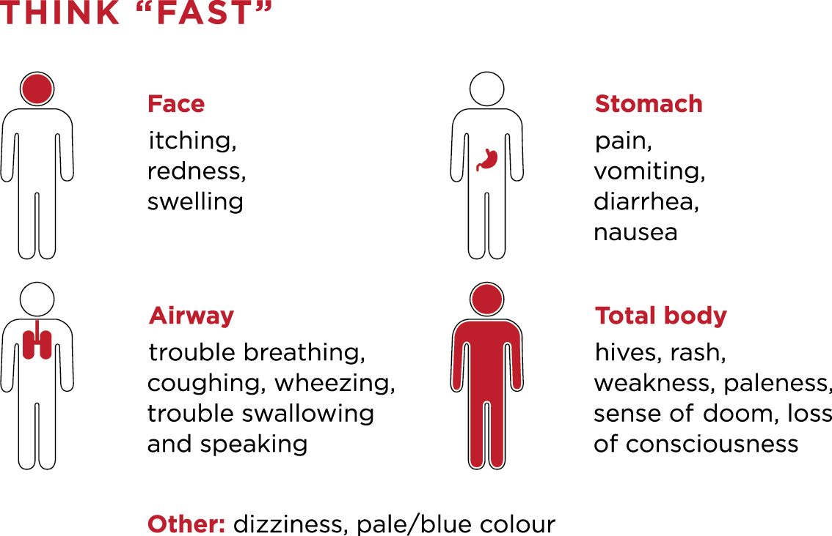
Signs & Symptoms
Notes:
Topic 6: Symptoms of an Allergic Reaction
Key Learning Points:
Learn that allergic reactions are very serious, potentially resulting in anaphylaxis.
Recognize the different symptoms of an allergic reaction.
When someone gets sick with an allergic reaction, it’s an emergency.
Speak up and get and adult right away.
Support your friends with allergies to tell you – not to keep it a secret.
Find out where their medicine is.
Suggested Materials: Symptoms of an Allergic Reaction
Activity: Discussion
Questions and Explanations
Have you ever had, or seen someone have an allergic reaction? What did you do?
What are some of the signs of an allergic reaction?
Cover all of the signs and symptoms with this hand “Think FAST” chart:
Who could you tell if you saw someone feeling really sick and needed help?
Why should you never keep an allergic reaction a secret? Why do you think someone might feel tempted to not tell anyone and go off alone?
Remind students that reactions worsen quickly and it’s important to get help from an adult right away.
Sometimes people might feel embarrassed if they are experiencing all of these strange symptoms. They also may not want to feel like a burden by asking for help from others. Always encourage your friends with allergies to tell you if they ever feel symptoms.
What phone number would you call in an emergency? What would you say on the phone?
911. Paramedics recommend that you use the word “anaphylaxis” on the phone so they are prepared when arriving at the scene.

Slide 21
7. Epinephrine Auto-Injectors
Notes:
Topic 7 - Epinephrine
Key Learning Points:
Epinephrine is an important medicine that can help with an allergic reaction.
It can commonly be referred to as an EpiPen®. They all have the same medicine inside – epinephrine.
They are not a toy and should never be played with.
It should be used upon the first signs of anaphylaxis and can help save a life.
Two doses should be carried in case the first dose does not help subdue the reaction.
Suggested Materials: Order the Emergency Procedure
Activity: Discussion & Demonstrating an Auto-Injector
Demonstrating an Auto-Injector – If an auto-injector trainer is available, show the class what it looks like and how it is used.
Questions and Explanations
What are examples of medicines that people need because of their health?
Puffers for asthma
Pills for certain conditions
Epinephrine for anaphylaxis
Why do we wear helmets, seatbelts, and wear equipment during some sports? How is carrying a medicine like epinephrine similar?
We use these to stay protected and minimize risk. Epinephrine also protects you when you need it. It’s best to have it than not.
What exactly is an epinephrine auto-injector (e.g. EpiPen®)
It is a needle, which is why we take them seriously and never play with them. They have one dose of medicine inside called epinephrine, which could help save a life during an anaphylactic reaction. EpiPen® is currently the most common know brand of epinephrine auto-injectors.
How do you think epinephrine works to help with an allergic reaction?
It helps in three important ways:
Tightens up blood vessels which reduces swelling.
Helps airways open up by relaxing muscles around the lungs
Prevents the release of further allergic chemicals.
What do you think the proper steps would be to handle an emergency involving a severe allergic reaction?
Step 1 – Use epinephrine
Step 2 – Call 911
Step 3 – Use a second dose if reaction is getting worse
Step 4 – Get to the hospital in an ambulance
Why should people with allergies always carry at least two doses?
Sometimes a reaction can be quite severe and need extra medicine to treat it.
What do you think it would be like to carry one around with you everywhere you go? Would it be easy? Why do you think that some people may unfortunately choose not to have it on them? What would affect that decision?
It can be difficult, especially if people carry it in different places (e.g. sport bag, backpack, purse etc.). If others tease someone about their auto-injector, it makes it harder to carry it and draw unwanted attention. It is so important to support those with food allergies as this medicine can help save their life.
If you ever saw one lying on the ground, should you ever touch it?
Never. Report it to a teacher right away. It is possible that someone dropped it and it’s important that an adult solves the problem as it contains a needle inside.
After someone uses adrenaline/epinephrine, where should they go and why?
They need to go to a hospital right away. Sometimes a reaction can get worse after using epinephrine. That’s why it’s so important to be looked at by doctors at a hospital to make sure the allergic reaction is gone.

Slide 22
Epinephrine Auto-Injectors
What are examples of medicine people need?
What is an “epinephrine auto-injector”?
Commonly known as an EpiPen®
Is it something to play or joke with?
EpiPen®, EpiPen® Jr are registered trademarks of Mylan, Inc. licensed exclusively to its wholly-owned affiliate, Mylan Specialty, L.P.; sub-licensee, Pfizer Canada Inc., Kirkland, Quebec H9J 2M5
Notes:
Topic 7 - Epinephrine
Key Learning Points:
Epinephrine is an important medicine that can help with an allergic reaction.
It can commonly be referred to as an EpiPen®. They all have the same medicine inside – epinephrine.
They are not a toy and should never be played with.
It should be used upon the first signs of anaphylaxis and can help save a life.
Two doses should be carried in case the first dose does not help subdue the reaction.
Suggested Materials: Order the Emergency Procedure
Activity: Discussion & Demonstrating an Auto-Injector
Demonstrating an Auto-Injector – If an auto-injector trainer is available, show the class what it looks like and how it is used.
Questions and Explanations
What are examples of medicines that people need because of their health?
Puffers for asthma
Pills for certain conditions
Epinephrine for anaphylaxis
Why do we wear helmets, seatbelts, and wear equipment during some sports? How is carrying a medicine like epinephrine similar?
We use these to stay protected and minimize risk. Epinephrine also protects you when you need it. It’s best to have it than not.
What exactly is an epinephrine auto-injector (e.g. EpiPen®)
It is a needle, which is why we take them seriously and never play with them. They have one dose of medicine inside called epinephrine, which could help save a life during an anaphylactic reaction. EpiPen® is currently the most common know brand of epinephrine auto-injectors.
How do you think epinephrine works to help with an allergic reaction?
It helps in three important ways:
Tightens up blood vessels which reduces swelling.
Helps airways open up by relaxing muscles around the lungs
Prevents the release of further allergic chemicals.
What do you think the proper steps would be to handle an emergency involving a severe allergic reaction?
Step 1 – Use epinephrine
Step 2 – Call 911
Step 3 – Use a second dose if reaction is getting worse
Step 4 – Get to the hospital in an ambulance
Why should people with allergies always carry at least two doses?
Sometimes a reaction can be quite severe and need extra medicine to treat it.
What do you think it would be like to carry one around with you everywhere you go? Would it be easy? Why do you think that some people may unfortunately choose not to have it on them? What would affect that decision?
It can be difficult, especially if people carry it in different places (e.g. sport bag, backpack, purse etc.). If others tease someone about their auto-injector, it makes it harder to carry it and draw unwanted attention. It is so important to support those with food allergies as this medicine can help save their life.
If you ever saw one lying on the ground, should you ever touch it?
Never. Report it to a teacher right away. It is possible that someone dropped it and it’s important that an adult solves the problem as it contains a needle inside.
After someone uses adrenaline/epinephrine, where should they go and why?
They need to go to a hospital right away. Sometimes a reaction can get worse after using epinephrine. That’s why it’s so important to be looked at by doctors at a hospital to make sure the allergic reaction is gone.

Slide 23
Epinephrine Auto-Injectors
Helps in several different ways
Tightens up blood vessels which reduces swelling.
Helps airways open up by relaxing muscles around the lungs
Prevents the release of further allergic chemicals.
Why should people carry two doses?
Notes:
Topic 7 - Epinephrine
Key Learning Points:
Epinephrine is an important medicine that can help with an allergic reaction.
It can commonly be referred to as an EpiPen®. They all have the same medicine inside – epinephrine.
They are not a toy and should never be played with.
It should be used upon the first signs of anaphylaxis and can help save a life.
Two doses should be carried in case the first dose does not help subdue the reaction.
Suggested Materials: Order the Emergency Procedure
Activity: Discussion & Demonstrating an Auto-Injector
Demonstrating an Auto-Injector – If an auto-injector trainer is available, show the class what it looks like and how it is used.
Questions and Explanations
What are examples of medicines that people need because of their health?
Puffers for asthma
Pills for certain conditions
Epinephrine for anaphylaxis
Why do we wear helmets, seatbelts, and wear equipment during some sports? How is carrying a medicine like epinephrine similar?
We use these to stay protected and minimize risk. Epinephrine also protects you when you need it. It’s best to have it than not.
What exactly is an epinephrine auto-injector (e.g. EpiPen®)
It is a needle, which is why we take them seriously and never play with them. They have one dose of medicine inside called epinephrine, which could help save a life during an anaphylactic reaction. EpiPen® is currently the most common know brand of epinephrine auto-injectors.
How do you think epinephrine works to help with an allergic reaction?
It helps in three important ways:
Tightens up blood vessels which reduces swelling.
Helps airways open up by relaxing muscles around the lungs
Prevents the release of further allergic chemicals.
What do you think the proper steps would be to handle an emergency involving a severe allergic reaction?
Step 1 – Use epinephrine
Step 2 – Call 911
Step 3 – Use a second dose if reaction is getting worse
Step 4 – Get to the hospital in an ambulance
Why should people with allergies always carry at least two doses?
Sometimes a reaction can be quite severe and need extra medicine to treat it.
What do you think it would be like to carry one around with you everywhere you go? Would it be easy? Why do you think that some people may unfortunately choose not to have it on them? What would affect that decision?
It can be difficult, especially if people carry it in different places (e.g. sport bag, backpack, purse etc.). If others tease someone about their auto-injector, it makes it harder to carry it and draw unwanted attention. It is so important to support those with food allergies as this medicine can help save their life.
If you ever saw one lying on the ground, should you ever touch it?
Never. Report it to a teacher right away. It is possible that someone dropped it and it’s important that an adult solves the problem as it contains a needle inside.
After someone uses adrenaline/epinephrine, where should they go and why?
They need to go to a hospital right away. Sometimes a reaction can get worse after using epinephrine. That’s why it’s so important to be looked at by doctors at a hospital to make sure the allergic reaction is gone.

Slide 24
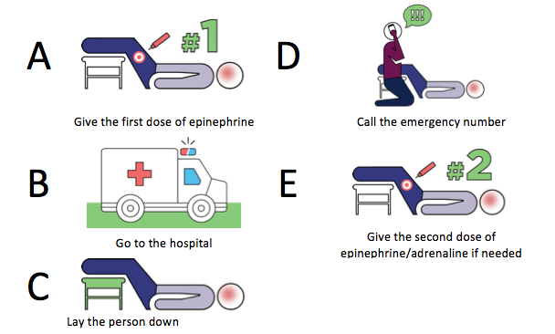
Epinephrine Auto-Injectors
What would be the correct order for the emergency procedure during an anaphylactic reaction?
Notes:
Topic 7 - Epinephrine
Key Learning Points:
Epinephrine is an important medicine that can help with an allergic reaction.
It can commonly be referred to as an EpiPen®. They all have the same medicine inside – epinephrine.
They are not a toy and should never be played with.
It should be used upon the first signs of anaphylaxis and can help save a life.
Two doses should be carried in case the first dose does not help subdue the reaction.
Suggested Materials: Order the Emergency Procedure
Activity: Discussion & Demonstrating an Auto-Injector
Demonstrating an Auto-Injector – If an auto-injector trainer is available, show the class what it looks like and how it is used.
Questions and Explanations
What are examples of medicines that people need because of their health?
Puffers for asthma
Pills for certain conditions
Epinephrine for anaphylaxis
Why do we wear helmets, seatbelts, and wear equipment during some sports? How is carrying a medicine like epinephrine similar?
We use these to stay protected and minimize risk. Epinephrine also protects you when you need it. It’s best to have it than not.
What exactly is an epinephrine auto-injector (e.g. EpiPen®)
It is a needle, which is why we take them seriously and never play with them. They have one dose of medicine inside called epinephrine, which could help save a life during an anaphylactic reaction. EpiPen® is currently the most common know brand of epinephrine auto-injectors.
How do you think epinephrine works to help with an allergic reaction?
It helps in three important ways:
Tightens up blood vessels which reduces swelling.
Helps airways open up by relaxing muscles around the lungs
Prevents the release of further allergic chemicals.
What do you think the proper steps would be to handle an emergency involving a severe allergic reaction?
Step 1 – Use epinephrine
Step 2 – Call 911
Step 3 – Use a second dose if reaction is getting worse
Step 4 – Get to the hospital in an ambulance
Why should people with allergies always carry at least two doses?
Sometimes a reaction can be quite severe and need extra medicine to treat it.
What do you think it would be like to carry one around with you everywhere you go? Would it be easy? Why do you think that some people may unfortunately choose not to have it on them? What would affect that decision?
It can be difficult, especially if people carry it in different places (e.g. sport bag, backpack, purse etc.). If others tease someone about their auto-injector, it makes it harder to carry it and draw unwanted attention. It is so important to support those with food allergies as this medicine can help save their life.
If you ever saw one lying on the ground, should you ever touch it?
Never. Report it to a teacher right away. It is possible that someone dropped it and it’s important that an adult solves the problem as it contains a needle inside.
After someone uses adrenaline/epinephrine, where should they go and why?
They need to go to a hospital right away. Sometimes a reaction can get worse after using epinephrine. That’s why it’s so important to be looked at by doctors at a hospital to make sure the allergic reaction is gone.

Slide 25
8. Inclusion
Notes:
Topic 8 – Inclusion
Key Learning Points:
We are all different in many ways.
Being different is what makes us all special, and altogether a stronger group.
People can be different because of food allergies, but they are still like everyone else.
People with food allergies can do everything that anyone else can do.
Food allergies are never a reason to exclude someone.
Suggested Materials: What makes you Unique? Allergy Awareness Pledge
Activity: Discussion, Circle of Differences, Instant Show & Tell
Circle of Differences – In a circle, ask everyone to say one unique thing about themselves. (E.g. a unique hobby, interest, challenge).
Instant Show & Tell - Ask students to pick to “show and tell” about something that they have on them. Whether it be certain shoes, a bracelet, a scar from a camping trip, and why it is important to them.
Classroom Discussion Questions:
What’s something that makes you unique?
How does it make someone feel if they were teased for being different?
It hurtful and frustrating when others tease about something that you cannot control. We are all different. Remind students about respective policies and punishments.
Why do you think people tease/bully? Is it fair?
How can being different be a good thing?
Our differences can help make our teams stronger by having different perspectives and views. If everybody was the same, there would not be much variety in life. Think of football team and all of the different skills needed to be a successful team.
How does it feel if someone does not invite you to a party or to hang out?
Remind students that this can often happen because of differences. Although you are not forced to hang out with anyone, be conscious of how it feels if you were in that position yourself. Remember to treat others the way you want to be treated.
What can we do at school to make sure everyone with food allergies are safe and feel included? At classroom celebrations? During lunchtime?
Remind students of related school policies.
Suggested Unit Overview: Food Allergy Jeopardy and Food Allergy Spelling Bee

Slide 26
Inclusion
What’s something that makes you unique?
Notes:
Topic 8 – Inclusion
Key Learning Points:
We are all different in many ways.
Being different is what makes us all special, and altogether a stronger group.
People can be different because of food allergies, but they are still like everyone else.
People with food allergies can do everything that anyone else can do.
Food allergies are never a reason to exclude someone.
Suggested Materials: What makes you Unique? Allergy Awareness Pledge
Activity: Discussion, Circle of Differences, Instant Show & Tell
Circle of Differences – In a circle, ask everyone to say one unique thing about themselves. (E.g. a unique hobby, interest, challenge).
Instant Show & Tell - Ask students to pick to “show and tell” about something that they have on them. Whether it be certain shoes, a bracelet, a scar from a camping trip, and why it is important to them.
Classroom Discussion Questions:
What’s something that makes you unique?
How does it make someone feel if they were teased for being different?
It hurtful and frustrating when others tease about something that you cannot control. We are all different. Remind students about respective policies and punishments.
Why do you think people tease/bully? Is it fair?
How can being different be a good thing?
Our differences can help make our teams stronger by having different perspectives and views. If everybody was the same, there would not be much variety in life. Think of football team and all of the different skills needed to be a successful team.
How does it feel if someone does not invite you to a party or to hang out?
Remind students that this can often happen because of differences. Although you are not forced to hang out with anyone, be conscious of how it feels if you were in that position yourself. Remember to treat others the way you want to be treated.
What can we do at school to make sure everyone with food allergies are safe and feel included? At classroom celebrations? During lunchtime?
Remind students of related school policies.
Suggested Unit Overview: Food Allergy Jeopardy and Food Allergy Spelling Bee

Slide 27
Inclusion
Should we ever tease someone for being different?
Why do people tease/bully? Is it fair?
Why is being different/unique a good thing?
How does it feel when you are not included?
What can we do to make sure everyone feels safe and included?

Slide 28
9. Activities

Slide 29
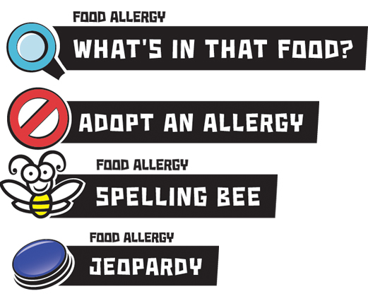
Activities
Notes:
Use the separate PowerPoint slides provided to run any of these activities.

